Slide 1
NAO Sprint 2 Review
C1C Christian Arnold
C1C Casey Born
C1C Adrian Chiriac
C1C Katrina Domeyer
C1C Colin Schnoes
C1C Jacob Taylor
Notes:
Casey

Slide 2
Sprint 1 Retrospective Meeting
Need to make better use of Scrum
Gained hours of familiarity with Nao System
Good distribution of Work
Use a combined demo in future
Need better hour tracking

Slide 3
Sprint 2 Backlog Items
Finish Rock-Paper-Scissors
Fix Choices (2 hr)
Add extra animations (4 hr)
Beta Testing (2 hr)
Fix access to code repository (30 min)
Sprint Review Prep
Demo (2 hr)
Presentation (2 hr)
Admin Framework (3 hr)
Notes:
Adrian

Slide 4
Sprint 2 Backlog Items (Cont.)
Finish High-Low
Code Exploration (6 hr)
Beta Testing (2 hr)
Attitude Dialog (2 hr)
Alter Star Wars Demo
Do not sit down at end (1 hr)
Explore Capabilities
Range Finding (5 hr)
Facial Recognition (5 hr)
Support Asimov’s 3 Laws (5 hr)

Slide 5
Sprint 2 Backlog Items (Cont.)
K-5 Emotions Demo
“I’m tired, I need a break”
“I’m confused”
Perform in an animated manner (6 hr)
Add additional responses (4 hr)
Happy
Sad
Excited
“Whatever” (Indifference)

Slide 6
Design Model
System architecture
Choregraphe
Risks
Health of the robot
Locating old source code
Compacted Schedule
4 lessons for Sprint Review
Notes:
Katie

Slide 7
Test Plan
Rock-Paper-Scissors
Test all possible inputs/outputs for the game
Player Testing
Stand-alone behaviors
Stability testing for movements
Notes:
First bullet – Christian talk about your testing process
Second bullet – Colin and Jacob talk about your stability testing process

Slide 8
Hour Tracking

Slide 9
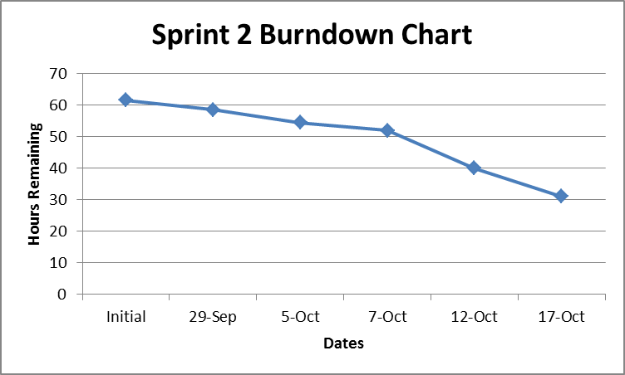
Sprint Burndown Chart

Slide 10
Demo

Slide 11
Anticipated Goals for Next Sprint
Continue Exploring Capabilities
K-5 Emotions Demo
Continue working on enhancing Rock-Paper-Scissors game with visual recognition
Fix the High-Low game.
Start work on the number recognition game.
Notes:
Katie

Slide 12
Summary and Takeaways
Robots are fragile
Sprint schedule was very compacted
Improve Work Efficiency
Based on 3 hours per lesson, 81% Efficiency
More Even Workload
Notes:
Katie

Slide 13
Documentation
None.

Slide 14
Questions?

